Slide 1
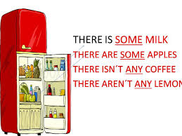
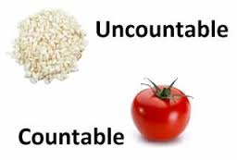
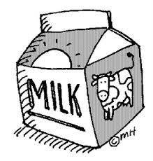
Countable and uncountable nouns. There is / are = hi ha …. ( singular and plural ). Quantifiers: How much … / How many …? Determiners: a / an, some, any, the.

Slide 2
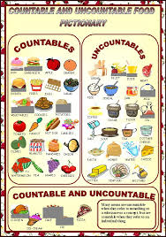
Countable and uncountable nouns:
Countable noun: it´s a noun that you can count.
A sandwich, a teacher, a pen, …
Uncountable noun: it´s a noun that you can not count.
Water, rice, shampoo, oil, wine, …

Slide 3
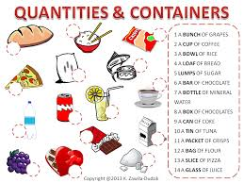
Attention!!!
An uncountable noun can be countable. How?
Using containers (glasses, bottles, briks, … ), litres, kg, ml, ...
a bottle of shampoo, a glass of water, two briks of milk, …

Slide 4
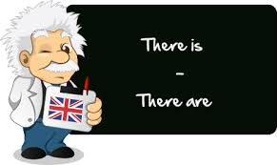

Slide 5
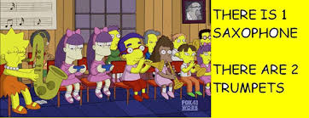
There is / are = hi ha …. ( singular and plural ).
Singular
( + ) There is ….
( - ) There is not / isn´t …
( ? ) [Wh- questions] + is there ….

Slide 6
Plural
( + ) There are ….
( - ) There are not / aren't …
( ? ) [Wh- questions] + are there …

Slide 7
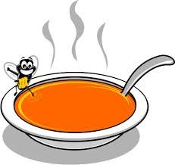
Examples:
There is = hi ha (singular)
(+) There is a fly in my soup.
( - ) There isn't a fly in my soup.
(?) Is there a fly in my soup?
(?) What is there in my soup? A fly?
Yes, there is / No, there isn´t.

Slide 8
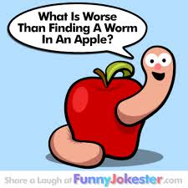
There are = hi ha (plural)
(+) There are some flies in my soup.
( - ) There aren't any flies in my soup.
(?) Are there any flies in my soup?
(?) What insects are there in my soup? Flies? Yes, there are / No, there aren´t.

Slide 9
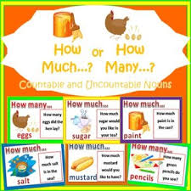
Quantifiers: How much … / How many …?
How much … Uncountable nouns (before uncountable nouns in singular): quant/quanta.
How much money have you got in your pocket?
How much homework have you got ?

Slide 10
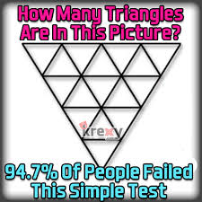
How many … Countable nouns (before plural nouns): quants / quantes.
How many coins have you got?
How many exercises have you got for homework?

Slide 11
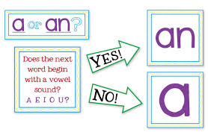
Determiners: a / an, some, any, the.
A/an (un/a): singular countable nouns.
a + consonant, a plane
an + vowel, an apple

Slide 12
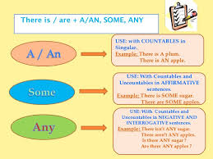
Some / any: countable nouns in plural / uncountable nouns in singular.
(+) ( - / ?)
I have got some pens. I bought some coffee.
I haven´t got any pens. I didn´t buy any coffee.
Have you got any pens? Did you buy any coffee?

Slide 13
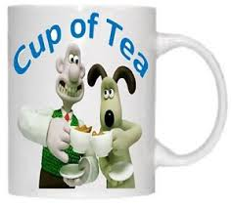
Attention!
Some in questions: offers or petitions that we expect “yes” as answer.
Would you like some coffee? Yes, please.
Can I have some water, please? Of course.

Slide 14
By Marga Alegre :)

